Slide 1

Day 4 Ansible
By Jitin Singh

Slide 2
Agenda
Before and After Configuration Management
What is Ansible?
Features of Ansible
Ansible Case Study : NASA
Ansible for Orchestration
Ansible for Provisioning
Ansible for Configuration Management
Ansible for Application Deployment
Ansible for Security
Write Ansible playbook to Install LAMP Stack and Host a Website
Notes:
today we'll be learning what
0:05
is so let's get
0:11
started with it first let us look at the topics that we'll be learning today well
0:16
it's quite a long list it means you'll be learning a lot of things today let us
0:21
take a look at them one by one the first we'll see the problems that we're before configuration management and how
0:28
configuration management helps to solve it we'll see what ansible is and the
0:33
different features of ansible after that we'll see how nasa is implemented ansible
0:39
to solve all their problems after that we'll see how we can use ansible for
0:44
orchestration provisioning configuration management application deployment and
0:49
security and in the end we'll write some ansible playbooks to install and stack on my node machine
0:56
and host a website in my node machine so guys I hope that you're all clear with
1:02
today's agenda

Slide 3
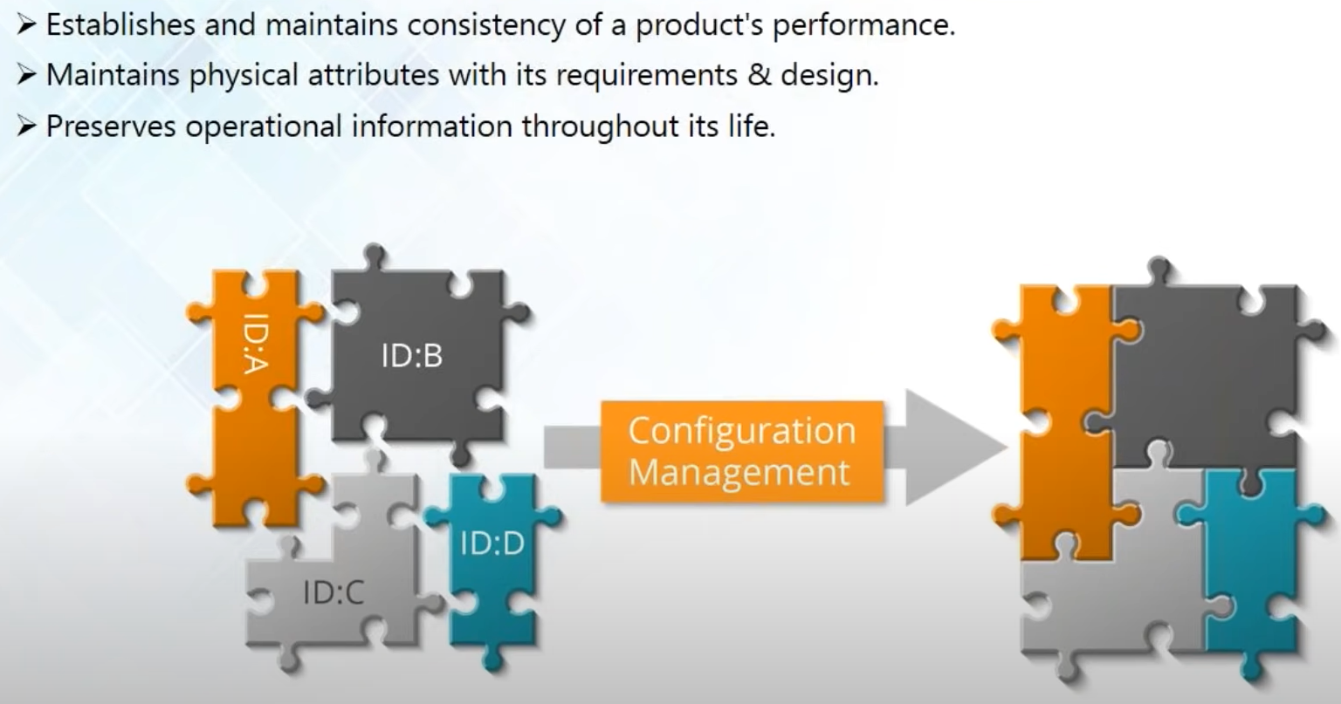
Configuration Management
Notes:
let
1:23
us first understand what configuration management actually is well configuration management is actually the
1:30
management of your software on top of your hardware what it does is that it
1:35
maintains the consistency of your product based on its requirements its design and its physical and functional
1:42
attributes now how does it maintain the consistency it is because the
1:47
configuration management is applied over the entire lifecycle of your system and hence it provides you with a very good
1:54
visibility and control ---when I said visibility it means that you can continuously check and monitor the
2:01
performances of all your systems so at any time the performance of any of your system is degrading ---the configuration
2:08
management system will notify you and hence you can prevent errors before it actually occours
2:13
---and by control I mean that you have the power to change anything if any of your servers fade you can reconfigure it
2:21
again to repair it so that it is up and running again or you can even replace the server--- if needed and also the
2:28
configuration management system holds the entire historical data of your infrastructure--- it documents all the
2:34
snapshots of every version of your infrastructure so over all the configuration management process
2:40
facilitates the orderly management of your system information and system changes so that it can use it for
2:46
beneficial purposes ----3:49
12:52
have any questions you can pop it in the chat window let us now move on to the next topic now the question is how do I
13:00
incorporate configuration management in my system well you do that using
13:05
configuration management tools let us take a look at all the available configuration management tools so here
13:12
I've got the four most popular tools that is available in the market right now I've got ansible and foul stack which
13:20
are push based configuration management tool by push-based I mean that you can directly push all those configurations
13:27
on to your node machines directly while chef and puppet are both full based
13:32
configuration management tools it means that they rely on a central server for configurations they pull all the
13:39
configuration from a central server there are other configuration management tools available in the market too but
13:45
but before are the most popular ones so now let's know more about ansible now
13:52
ansible is a configuration management tool that can be used for provisioning orchestration application deployment
13:59
automation and it's a push based configuration management tool like I told you what it does is that it
14:05
automates your entire IT infrastructure and gives you large productivity gains
14:11
and it can automate pretty much anything it can automate your cloud your network your servers and all your IT processes
14:18
ok I've got a question from Dikshit up what does automation exactly mean it's a

Slide 4
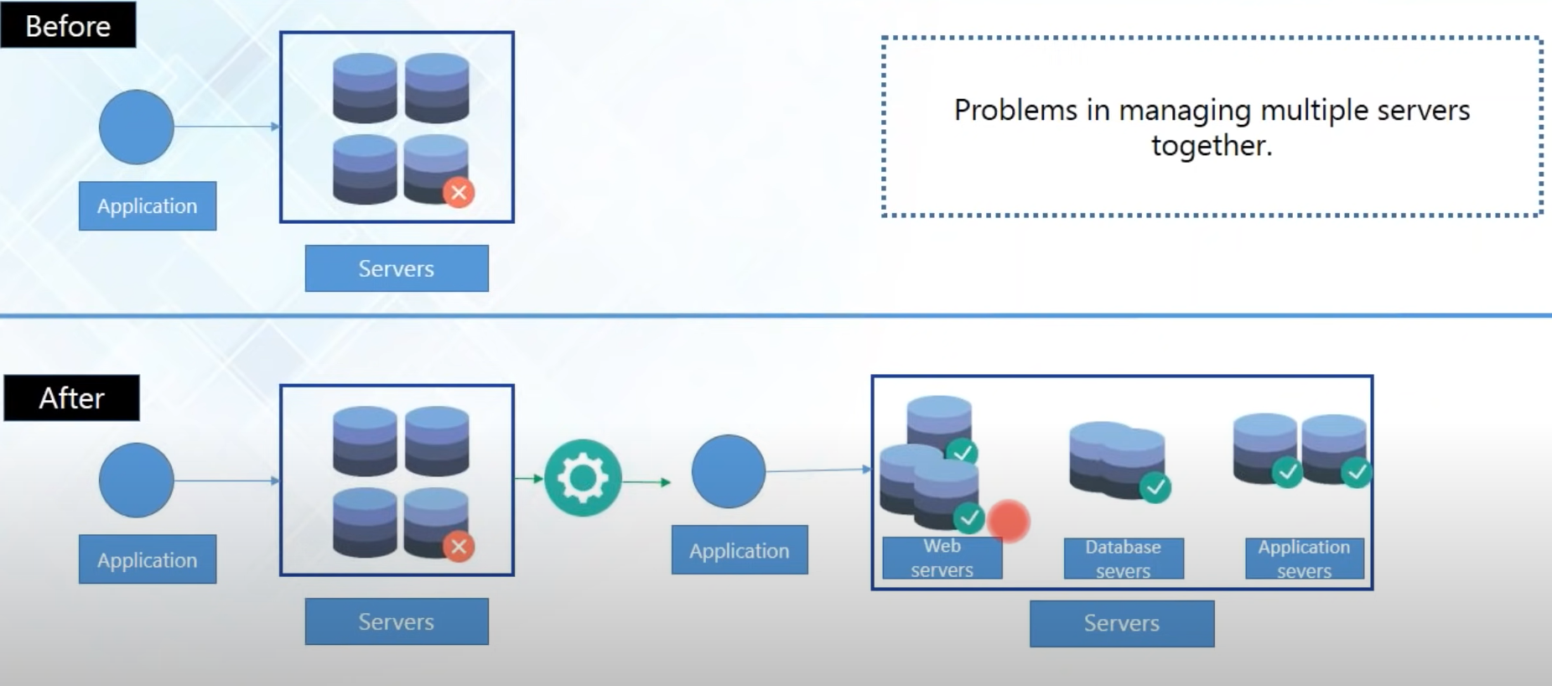
Before Configuration Management
Notes:
let us take a look at them one by one so the first problem was managing multiple servers now earlier
4:22
every system was managed by hand and by that I mean that you have to login to them via SD such make changes
4:30
and then log off again now imagine if the system administrator would have to make changes and most of the number of
4:37
servers you'll have to do this task of logging in making changes and long enough again and again repeatedly so
4:44
this would take up a lot of time and there is no time left for the system administrators to monitor the
4:50
performances of the system continuously safe at any time any of the servers would fail it took a lot of time people
4:57
detect the faulty server and took even more time to repair it because the
5:02
configuration scripts that they wrote was very complex and it was very hard to make changes on to them after
5:09
configuration management system came into the picture what it did is that it divided all the systems in my
5:15
infrastructure according to their dedicated task their design or architecture and the organized mess
5:21
system in an efficient way like I've grouped my web servers together my database servers together
5:28
application servers together and this process is known as baselining
5:34
now let's for an example say that I wanted to install lamb stack in my system and lamp stack is a software
5:40
bundle where L stands for Linux a for Apache M for MySQL and P for PHP so I
5:47
need this different software's for different purposes like I need Apache server to host my web pages
5:53
I need PHP for my web development I need Linux as my operating system and MySQL
6:00
as my data definition language or data manipulation language since now all the
6:05
systems in my infrastructure is baseline I would know exactly where to install each of the software's for example I'll
6:12
use Apache as my web server here for database I will install the MySQL here and also began easy for me to monitor my
6:19
entire system for example if my web pages are not running I would know that there is something wrong with my web
6:24
servers so I'll go check in here I don't have to check the database servers and application servers for that similarly
6:31
if I'm not able to insert data or extract data from my database I will know that something is wrong with my
6:37
database servers I don't need to check these two for that matter so what configuration management system did with baselining is that an
6:44
organized mess system in an efficient way so that I can manage and monitor all my servers efficiently

Slide 5
Second reason
Notes:
let us proceed to the next topic and see the problems before
3:55
configuration management and how configuration management solved it and with that we'll understand more about
4:01
configuration management as well so let's see now--- why do we need configuration management now --the
4:08
necessaries behind configuration management was dependent upon a certain number of factors and certain number of
4:14
reasons so ----so guys I hope
6:51
you've understood this if you have any questions you can always pop it in the chat window and anytime now let us see
6:58
the second problem that we had which was scaling up and scaling down see nowadays
7:05
you can come up with requirements at any time and you might have to scale up or
7:10
scale down your systems on the fly and this is something that you cannot always plan ahead and scaling up your
7:17
infrastructure doesn't always mean that you just buy new hardware and displace them anywhere happily you cannot do that
7:25
you also need to provision and configure these new machines properly so with configuration management system
7:31
I've already got my infrastructure baseline final exactly how these new machines are going to work according to
7:38
their dedicated task and where should I actually place them and the scripts that configuration management uses are
7:45
reusable so you can use the same scripts that you use to configure your older machines to configure your new machines
7:51
as well let me explain it to you with an example let me explain it to you with an
7:57
example let's say that if you're working in an e-commerce website and they decide
8:02
to hold a mega sale a new your Christmas sale or anything so it's obvious that there is going to be a huge rise in the
8:09
traffic so you might need more web servers to handle that amount of requests and you might even need a load
8:16
balancers or maybe to to distribute that amount of traffic onto your web servers and these changes however need to be
8:23
made at a very short span of time so after you've got the necessary hardware you also need to provision them
8:29
accordingly and with configuration management you can easily provision these new machines using either recipes or play books or
8:36
any kind of script that configuration management uses and also after the sale is over you don't need that many web
8:42
servers or load balancer so you can disable them using the same easy scripts as well and also scaling down it's very
8:50
important when you're you in cloud services when you do not need any of those machines it's no point in
8:56
keeping them so you have to scale down as well because you have to reconfigure your entire infrastructure as well and
9:01
with configuration management it is a very easy thing to auto scale up and scale down your infrastructure so I
9:07
think you all have understood this problem and how configuration management solves it so let us take a look at the
9:13

Slide 6
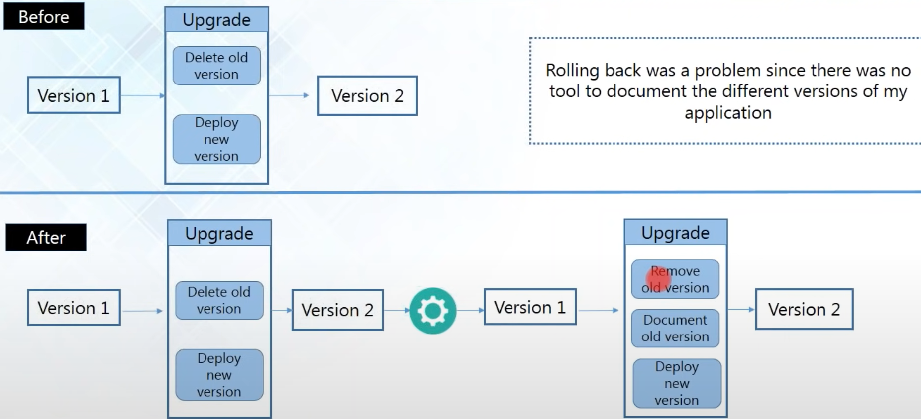
Third Problem
Notes:
the last problem now the last problem
10:52
was rolling back and today's scenario everyone wants to change and you need to
10:58
keep making changes frequently because customers will start losing interest if things stay the same
11:04
so you need to keep releasing new features to upgrade your application even giants like Amazon and Facebook
11:11
they do it now and then and still they are unsure if the users are going to like it or not now imagine if the users
11:18
did not like it they would have to roll back to the previous version again let's see how it creates a problem now before
11:25
there was configuration management let's say you've got the old version which is the version 1 when you're upgrading it
11:32
you're changing all the configurations in the production server you're deleting the old configurations completely and
11:37
deploying the new version now if the users did not like it you would have to reconfigure this
11:44
server again with the old configurations and that will take up a lot of time your application is going to be down for that
11:51
amount of time that you need for reconfiguring the server and this might create a problem but when you're using
11:57
configuration management system as we know that it documents every version of your infrastructure when you're
12:04
upgrading it with configuration management it will remove the configurations of the older version but
12:10
it will be well-documented it will be kept there and then the newer version is deployed now if the users did not like
12:17
it this time the older of configuration version was already documented so all you have to do is just switch back to
12:23
the old version and this won't take up any time and you can upgrade or rollback your application in zero downtime zero
12:32
downtime means that your application would be down for zero time it means that the users will not notice that your
12:39
application went down and you can achieve it seamlessly and this is how configuration management system solves
12:46
all the problems that works before so guys I hope that if all understood how configuration management did that

Slide 7
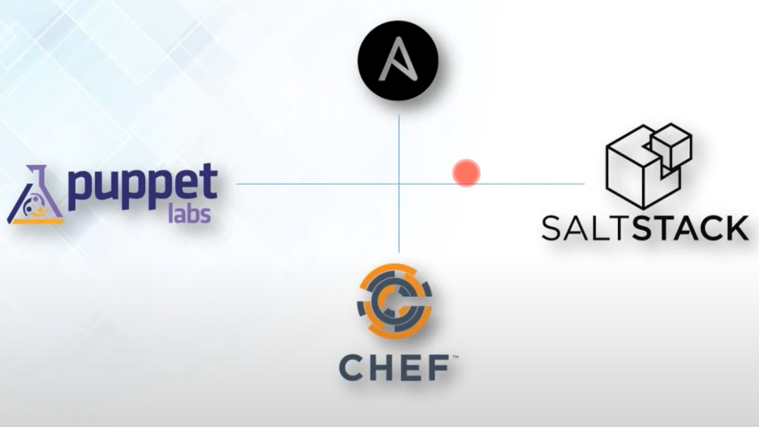
Configuration Management Tools
Notes:
let us now move on to the next topic now the question is how do I
13:00
incorporate configuration management in my system well you do that using
13:05
configuration management tools let us take a look at all the available configuration management tools so here
13:12
I've got the four most popular tools that is available in the market right now I've got ansible and foul stack which
13:20
are push based configuration management tool by push-based I mean that you can directly push all those configurations
13:27
on to your node machines directly while chef and puppet are both full based
13:32
configuration management tools it means that they rely on a central server for configurations they pull all the
13:39
configuration from a central server there are other configuration management tools available in the market too

Slide 8
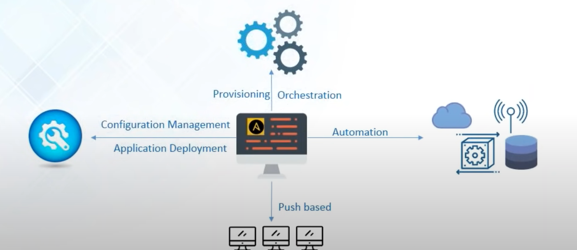
What is Ansible?
Notes:
let's know more about ansible now
13:52
ansible is a configuration management tool that can be used for provisioning orchestration application deployment
13:59
automation and it's a push based configuration management tool like I told you what it does is that it
14:05
automates your entire IT infrastructure and gives you large productivity gains
14:11
and it can automate pretty much anything it can automate your cloud your network your servers and all your IT processes

Slide 9
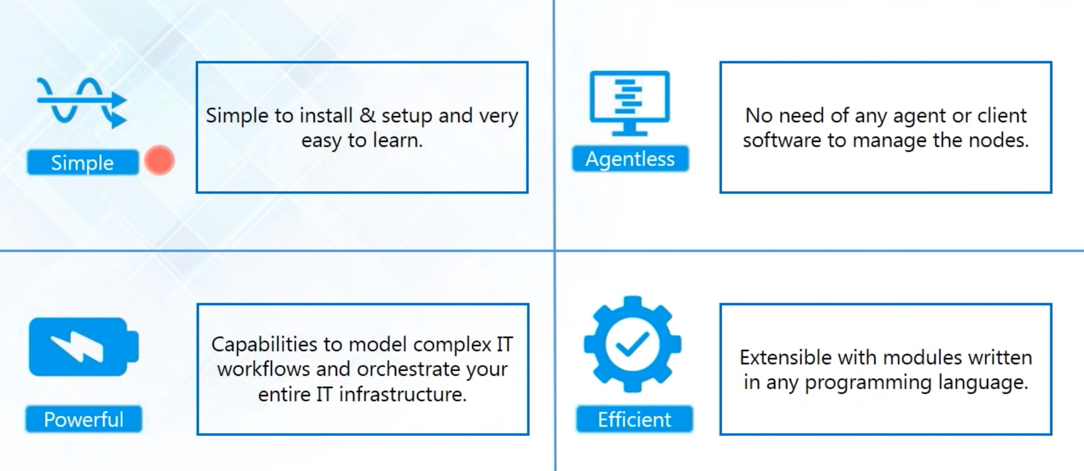
Feature of Ansible
Notes:
I told you what it does is that it
14:05
automates your entire IT infrastructure and gives you large productivity gains
14:11
and it can automate pretty much anything it can automate your cloud your network your servers and all your IT processes
14:18
ok I've got a question from Dikshit up what does automation exactly mean it's a
14:25
very good question Vic sure thank you so much well you can think of automation as a solution for turning your
14:31
infrastructure administration into a code base and it described all the processes necessary for deploying a
14:38
server in a set of provisioning scripts that can be reused again well an easy
14:43
word stick shift our automation is just writing a script about how and what you want all your systems to do and don't
14:50
worry we've been learning how to write the scripts and ansible they're called answer the playbooks and we'll be
14:56
learning that later in this tutorial so this r is clear with what automation is give me a quick
15:01
confirmation on the chat window so that I can proceed ok she says yes so let us
15:08
move on to the next topic so now let us see the features of ansible the first
15:14
feature is that it's very simple it's simple to install and setup and it's
15:19
very easy to learn because ansible playbooks are written in a very simple data serialization language which is
15:26
known as Gamal and it's pretty much like English so anyone can understand that and it's very
15:32
easy to learn next feature because of which ansible is preferred over other configuration management tools is
15:38
because it's agentless it means that you do not need any kind of agents or any kind of client
15:44
softwares to manage your node machines all you have to do is install an sigil
15:49
in your control machine and just make an SSH connection with your nodes and start pushing configurations right away the
15:57
next feature is that it's very powerful even though you call ansible simple and it does not require any agent it has the
16:04
capabilities to model very complex IT workflows and it comes with a very
16:10
interesting feature which is called the batteries included it means that you've got everything that you already need and
16:17
in ansible it's because it comes with more than 750 inbuilt modules which you
16:23
can use them for any purpose in your project and it's very efficient because
16:29
all the modules that ansible comes with they are extensible it means that you
16:34
can customize them according to your needs and for doing that it do not need to use the same programming language
16:40
that it was originally written in you can choose any kind of programming language that you're comfortable with
16:46
and then customize those modules for your own use this is the power and
16:51
liberty that ansible gives you so hope guys that is all understood the features these are pretty simple

Slide 10
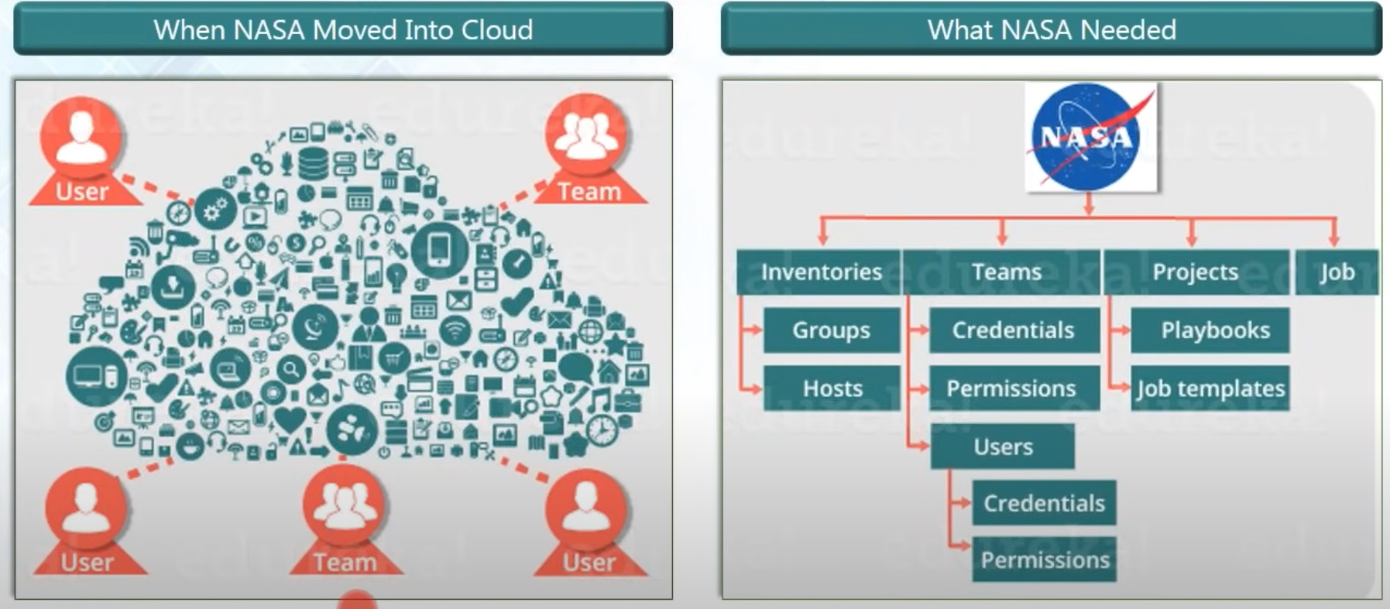
NASA Use Case
Notes:
the case study of NASA what were the problems that NASA was facing and how ansible solved all those problems now
17:13
NASA is an organization that has been sending men to the moon they are carrying out missions and Mars and
17:19
they're launching satellites now and then to monitor the earth and not just
17:25
the earth they are even monitoring other galaxies and other planets as well so you can imagine the kind and the amount
17:32
of data that NASA might be dealing with but all the applications were in a traditional hardware based data center
17:39
and they wanted to move into a cloud-based environment because they wanted better agility and
17:45
they wanted better adaptive planning for that and also they wanted to save costs
17:51
because a lot of money was spent on just the maintenance of the hardware and also
17:56
they wanted more security because NASA is a government organization of the United States of America and obviously
18:02
they wanted more security because NASA is a government organization of the United States of America and hold a lot
18:10
of confidential details as well for the government so they just cannot always rely on the hardware to store all these
18:16
confidential files they needed more security because if at any time the hardware fails they cannot afford to
18:23
lose that data and that is why they wanted to move all their 65 applications
18:28
from a hardware environment to a cloud-based environment now let us take a look what was the problem now for this
18:36
migration of all the data into a cloud environment they contacted a company called in frozen now in frozen is a
18:43
company who is a cloud broker and integrator who implement solutions to meet needs with security so incident was
18:51
responsible for making this transition and now if I wanted to make this transition in a very short span of time
18:57
so all the applications were migrated as it is into the cloud environment and
19:02
because of this all the AWS accounts and all the virtual private clouds that was
19:08
previously defined they all got accumulated in a single data space and this made of a huge chunk
19:14
of data and NASA had no way of centrally managing it and even simple tasks like
19:20
giving a particular system administrator access rights to a particular account this became a very tedious job well NASA
19:27
wanted to automate end to end deployment of all their apps and for that they needed a management system so this was
19:34
the situation when NASA moved into the cloud so you can see that all those AWS accounts and virtual private clouds
19:41
they've got accumulated and made a huge chunk of data and everyone was accepting directly to it so there is a problem in
19:47
managing the credentials for all the users and the different teams but NASA needed was divide up all their
19:54
inventories all their into group and number of holes and also
20:00
they wanted to divide up all the users into different teams and give each team different credentials and permissions
20:06
and also if you look in the more granular level each user in each team could also have different credentials
20:12
and permissions let's say that you want to give the team leader of a particular team access to some kind of data but I
20:18
don't want the other users in the team to access that data also NASA wanted to define different credentials for each
20:25
individual member as well they wanted to divide up all the data according to the projects and jobs also now I wanted to
20:33
move from chaos into a more organized manner and for that they adopted ansible
20:39
Tower now ansible tower is ansible in more enterprise level ansible

Slide 11
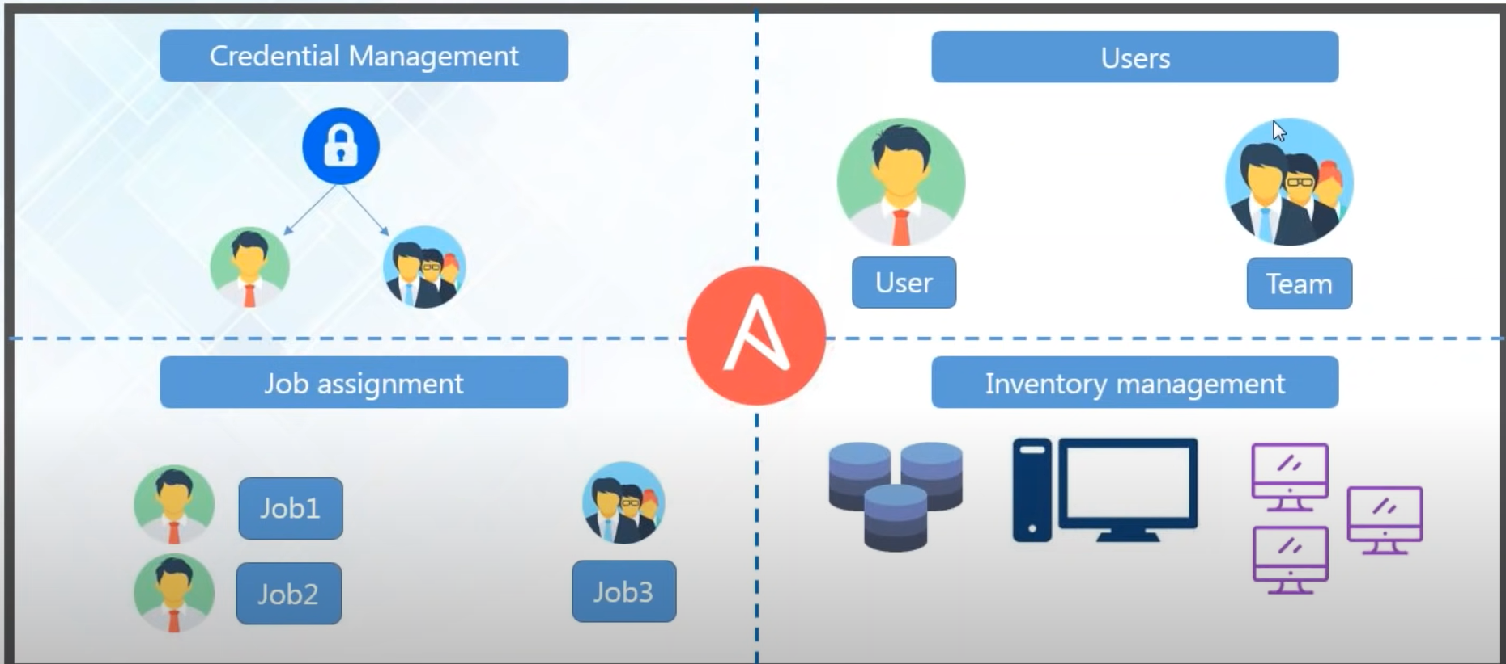
Ansible Tower
Notes:
ansible tower is ansible in more enterprise level ansible tower
20:45
provides you with the dashboard which provides all the state of summary of all the hosts and jobs now anthem of tower
20:52
is a web-based interface for managing your organization it provides you with
20:58
they're very easy to use user interface for managing quick deployments and monitoring all the configurations let's
21:05
see what ansible tower did it has a credential management system which could give different access permission to each
21:11
individual user and teams and also divided of the user into teams and
21:17
single individual users as well and it has a job assignment system and you can
21:23
also assign jobs using ansible tower it's supposed let's say that you have assigned job one to a single user job to
21:30
another single user while job c would be assigned to a particular team similarly the whole invention was also managed all
21:37
the servers let's say dedicated to a particular mission was grouped together all the host machines and other systems
21:43
as well sensible tower

Slide 12
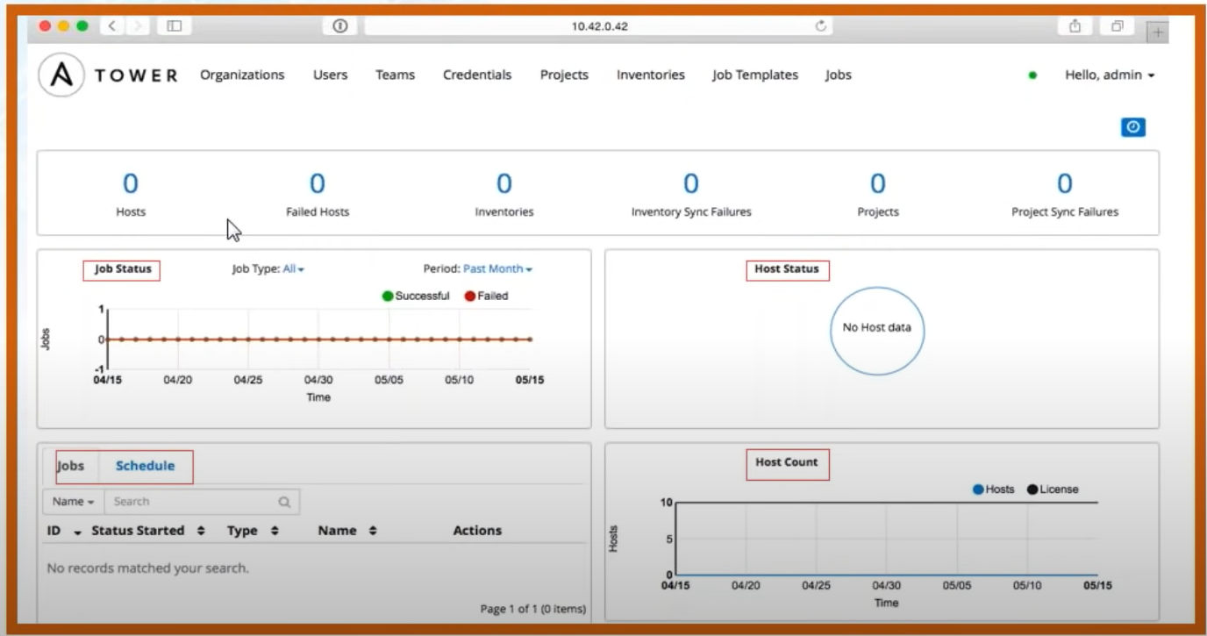
Ansible Tower UI
Notes:
now let us take a look at the
21:48
dashboard that ansible tower provides us so this is the screenshot of the dashboard at a very initial level you
21:55
can see right now there are 0 hosts nothing is there but I'm just showing you what ansible tower provides you so
22:02
on the top you can check all the users and teams you can manage the credentials from here you can check your different
22:08
project and inventories you can make job templates and shed you with jobs as well
22:14
so this is where you can schedule jobs and provide every job with a particular ID so that you can track it you can take
22:21
your job status here whether your job was successful or failed and since ansible tower is a
22:26
configuration management system it will hold the historical data as well so you can take the job statuses of the past
22:33
month or the month before that you can check the whole status as well you can
22:38
check how many hosts are up and running you can see the host count here so this dashboard of ansible tower provides you
22:45
with so much ease of monitoring all your systems so it's very easy to use ansible tower dashboard anyone in your company
22:51
anyone can use it because it's very user friendly

Slide 13

NASA Use Case
Updating nasa.gov went from 1h to 5 minutes
Security Patching updates went from multi-day process to 45 minutes
Provisioning OS accounts across entire environment in under 10 minutes
Application stacks set up time reduced from 1-2 hours to 10 minutes
Achieved near real-time RAM & disk monitoring
Baselining standard AMIs went from 1 hour manual process to becoming a seamless invisible background process
Notes:
now let us see the results that NASA
22:56
achieved after it has used ansible Tower now updating nasa.gov used to take one
23:02
hour of time and after using ansible it got down to just five minutes security
23:09
patching updates we're a multi-day process and now it requires only 45 minutes the provisioning of OS accounts
23:17
can be done in just 10 minutes earlier the application stack up time required
23:23
one to two hours and now it's done in only 10 minutes it also achieved near
23:28
real-time ram and disk monitoring and baselining all the standard Amazon machine images
23:33
this used to be a one hour manual process and now you don't even need manual interference for that it became a
23:40
background invisible process so you can see that how ansible has drastically changed the overall management system of
23:46
nasa

Slide 14
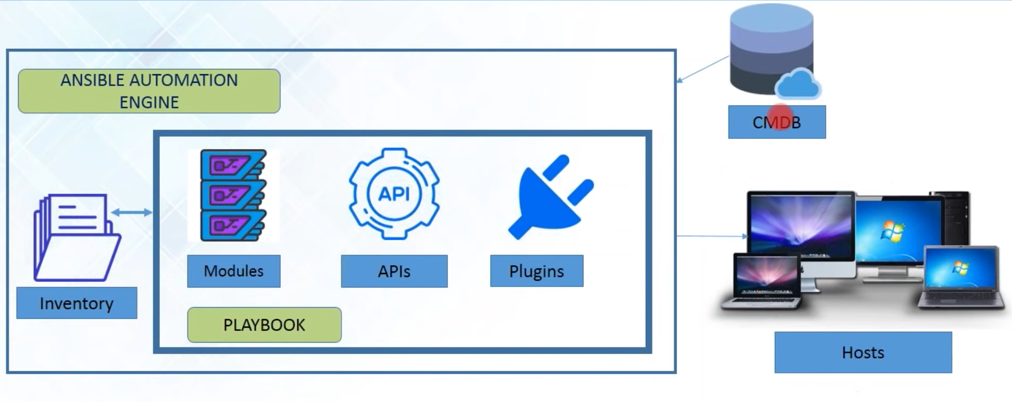
Ansible Architecture
Notes:
next topic now this is all about how others have use ansible so now let us
24:02
take a look at the ansible architecture so that we can understand more about ansible and decide how we can use
24:08
ansible so this is the overall ansible architecture I've got the ansible automation engine and I've got the
24:15
inventory and a playbook inside the automation engine I've got the configuration management database here
24:21
and host so where does it store all the configuration details this is stored in
24:28
this configuration management database which could be in your cloud or it isn't could be in your bare metal server and
24:34
this configuration management database is a repository that acts as the data
24:39
warehouse for all your IT installations it holds all the data relating to the
24:44
collection of your all IT assets and these are commonly known as configuration items and it also holds
24:50
the data which describe the relationships between such assets so this is a repository for all your
24:57
configuration management data and here I've got the ansible automation engine I've got the inventory and inventory is
25:04
nothing but the list of all the IP addresses of all my host machines now as
25:09
I told you how to use configuration management you use it with the configuration management tool like
25:15
ansible but how do you use ansible well you do that using playbook and playbook
25:21
describe the entire workflow of your system inside play books have got
25:27
modules api's and plugins now modules are the core files now play books
25:33
contain a set of place which are a set of tasks and inside every task there is
25:39
a particular module so when you run a playbook it's the modules that actually get executed on all your node machines
25:46
the models are the core files and like I told you before ansible already comes with inbuilt modules which
25:53
you can use and you can also customize them as well it comes with a different cloud module database modules and don't
26:00
worry I'll be showing you how to use those modules in ansible and there are different API is as well well API is and
26:08
ansible are not meant for direct consumption they're just there to support the command line tools for
26:14
example they have the Python API and these API is can also be used as a transport for cloud services whether
26:20
it's public or private you can use it then ascott plugins now plugins are a
26:25
special kind of module that allow to execute ansible tasks as a job build step and plugin for pieces of code that
26:33
argument the ansible core functionality and ansible also comes with a number of handy plugins that you can use for
26:39
example you have action plugins cash plugins callback plugins and also you
26:44
can create plugins of your own as well let me tell you how exactly different it is from a module let me give you the
26:50
example of action plug-in now I can plug in our front-end modules and what it
26:56
does is that when you start running a playbook something needs to be done on the control machine as well so this
27:02
action plugins trigger those action and execute those tasks in the controller machine before calling the actual
27:10
modules that are getting executed in the playbook and also you have a special kind of plugin called the connection
27:16
plug-in which allows you to connect to the docker containers in your node machine and many more and finally have
27:24
this host machine that is connected via SSH and these host machines could be
27:29
either Windows or Linux or any kind of machines and also let me tell you that
27:34
it's not always needed to use as I said for connection you can use any kind of network authentication protocol you can
27:41
use Kerberos and also you can use the connection plugins as well so this is fairly a very simple ansible
27:47
architecture

Slide 15
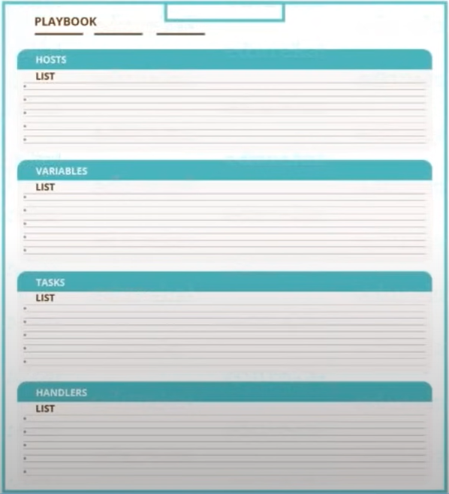
Playbook
Playbooks are simple files written in AML code.
It can declare configurations & orchestrate manual ordered processes
Can launch tasks Synchronously or asynchronously.
Notes:
now that you've understood the architecture let us write
28:00
a playbook now now let me tell you how to write a play book and playbooks and ansible are simple files written in
28:07
Yambol code and yeah mo is a data serialization language you can think of data serialization language as a
28:14
translator for breaking down all your data structure and serialize them in a particular order which can be
28:20
reconstructed again for later use and you can use this reconstructed data structure in the same environment or
28:26
even in a different environment so this is a control machine where ansible will be installed and this is where you'll be
28:32
writing your playbooks let me show you the structure of how to write a playbook now every playbook starts with three
28:39
dashes on the top the first thing have to mention the list of all your host machines here it means where do you want
28:46
this playbook to run then you can mention very by gathering facts then you can mention
28:51
the different tasks that you want now remember that the past get executed in the same order that you write them for
28:59
example you want to install software a first and then softer beef later on to
29:04
make sure that the first task would be install software and the next house could be install software B and then
29:10
I've got handlers at the bottom the handles are also tasks but the difference is in order to execute
29:17
handlers you need some sort of triggers in the list of tasks for example we use
29:22
notify

Slide 16
Example to install Ansible
---
- hosts: webservers
tasks:
-name: install apache2
apt: name=apache2 update_cache=yes state=latest
handlers:
-name: restart apache2
service: name=apache2 state=restarted
Notes:
I'll show you an example now ok let me show you an example of playbook so that you can relate to this structure
29:29
so this is an example of an ansible playbook to install Apache like a tolling starts with three dashes on the
29:36
top remember that every list starts with a dash in the front or a hyphen here are
29:43
only mentioned just the name of one group you can mention the name of several groups where you want to run your PlayBook then I've got the tasks
29:50
you give a name for the task which is install Apache and then you use a module
29:55
Here I am using the apt module to download the package so this is the
30:01
syntax of writing the apt module to give the name of the package which is Apache
30:06
to update cache is equal to yes it means that it'll make sure that apt-get is
30:11
already updated in your node machine before it installs the Apache - and in mentioned state equal to latest it means
30:18
that it will download the latest version of Apache - and this is the trigger because I'm using Handler is here right
30:25
and the handler here is to restart Apache and I'm using the service module
30:30
here and the name of the software that I want to restart is Apache - and state is
30:35
equal to restart it then notifies mentioned that there is going to be a handler whose job would be to restart
30:41
Apache - and then the tasks in the handler would get executed and we to restart Apache - so this is a simple
30:48
playbook and we'll also be writing similar kind of play books later on the hands-on part so you'll be learning
30:54
again so if it's looking a little gibberish for you will be doing on that on the hands-on part so then it will
31:00
clear all your doubts

Slide 17
How to use Ansible?
Orchestration
Provisioning
Configuration Management
Application Deployment
Security Compliance

Slide 18
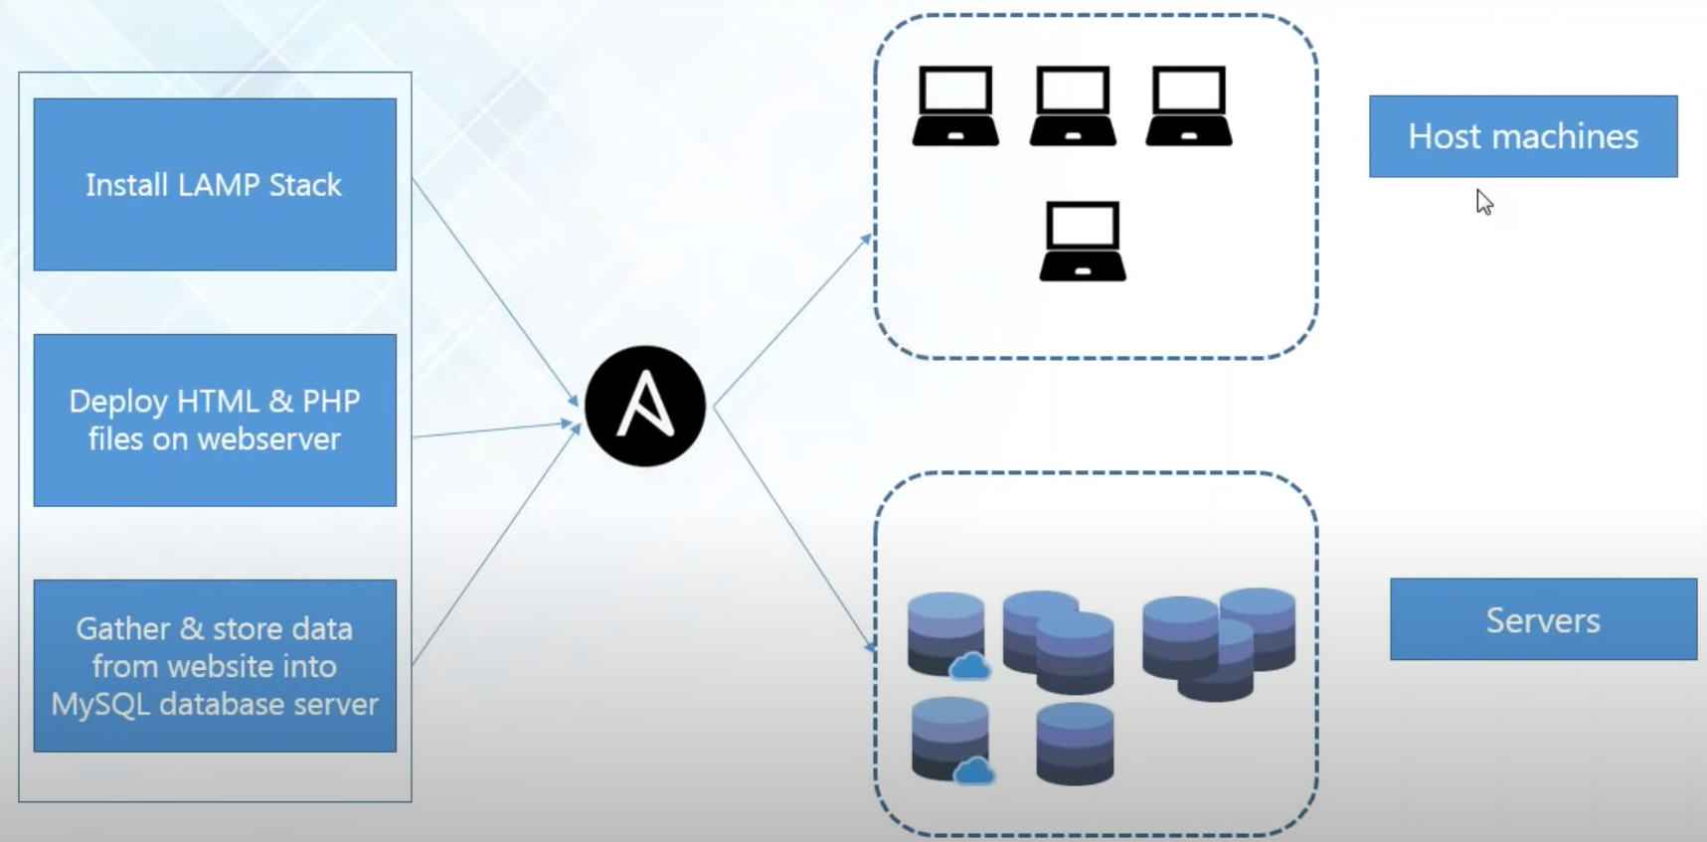
Orchestration
Notes:
let's say that I want to host a website on my node machines and this is precisely what we're going to do later
32:53
on the hands-on part so first and in order to do that first I have to install
32:59
the necessary software which is the lamp stack and after that I have to deploy all the HTML and PHP files on the web
33:06
server and after that I'll be gathering some kind of information from my web pages that will go inside my database
33:12
server now if you want to perform these out you have to make sure that the necessary software that installs the first I
33:19
cannot deploy the HTM and PSD files on the web servers if I don't have the web servers if a party is not installed so
33:27
this is orchestration where you mentioned that the task that needs to be carried out before and the task that
33:32
needs to be carried out later so this is what ansible Play Books allow you to do

Slide 19
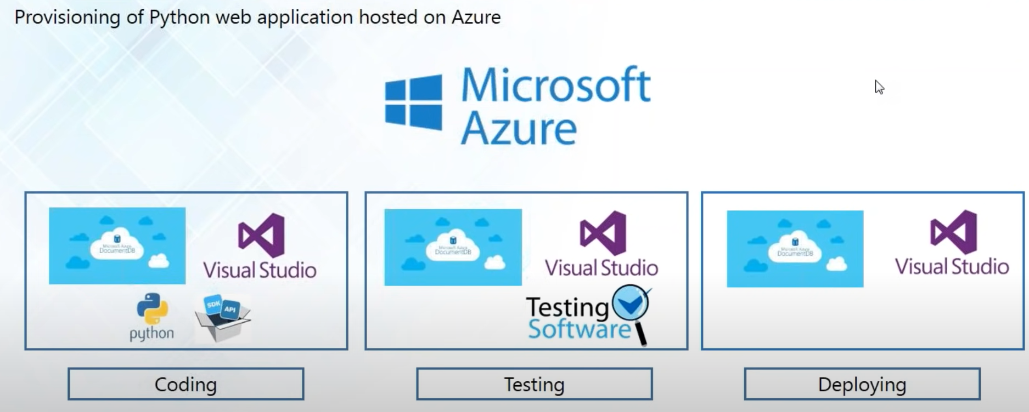
Provisioning
Notes:
what provisioning is
33:51
like provisioning in English means to provide with something that is needed it is same in case of ansible it means that
33:59
ansible will make sure that all the necessary softwares that they need for your application to run is properly
34:06
installed in each of the environment of your infrastructure let us take a look at this example here to understand what
34:12
provisioning actually is nice I want to provision a Python web application that I'm hosting on Microsoft Azure and
34:19
Microsoft Azure is very similar to AWS and it is also a gout platform on which
34:25
you can build up all your applications so let's say so nice I want to host my
34:30
sis I'm developing a Python web application for coding I would need the
34:35
Microsoft if your document database I would mean Visual Studio we need to install Python also and some kind of
34:42
software development kit and different API for that so ansible you can list out the name of all the
34:49
software development kits and all this necessary software's that you will require for coding this web that it
34:55
would require in order to develop your web application so you can list out all the necessary software's that you'd be
35:02
needing in an ansible playbook in order to develop your web application and for
35:07
testing your code out you will again need Microsoft reviewer document database you would again this visual
35:13
studio and some kind of testing software again you can list out all the software's in ansible playbook and it
35:19
would provision your testing environment as well and it's the same thing while you're deploying it on the production server as well ansible will provision
35:27
your entire application at all stages at coding stage testing and at the production stage also so guys I hope
35:34
you've understood what provisioning is

Slide 20
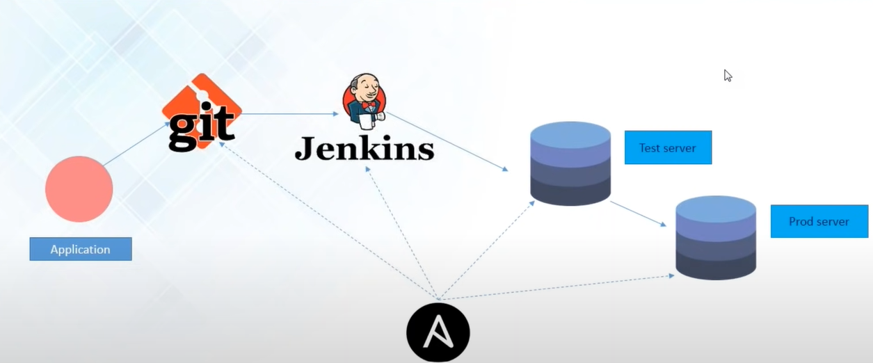
Application Deployment
Notes:
let's say that I am
38:01
using a version control system like git while I'm developing my app and also I'm
38:07
using Jenkins for continuous integration now Jenkins will extract gold from get
38:12
every time there is a new commit and then major software build and later this build will get deployed in the test
38:19
server for testing now as changes are kept making in the codebase continuously
38:24
you will have to configure your tests and the production server continuously as well according to the changes so what
38:31
ansible does is that it continuously keeps on checking the version control system here so that it can configure the
38:37
tests and the production server accordingly and quickly and hence it makes your application deployment like a
38:43
piece of cake
don't worry and the hands-on part will also be deploying our own applications on different servers as well

Slide 21
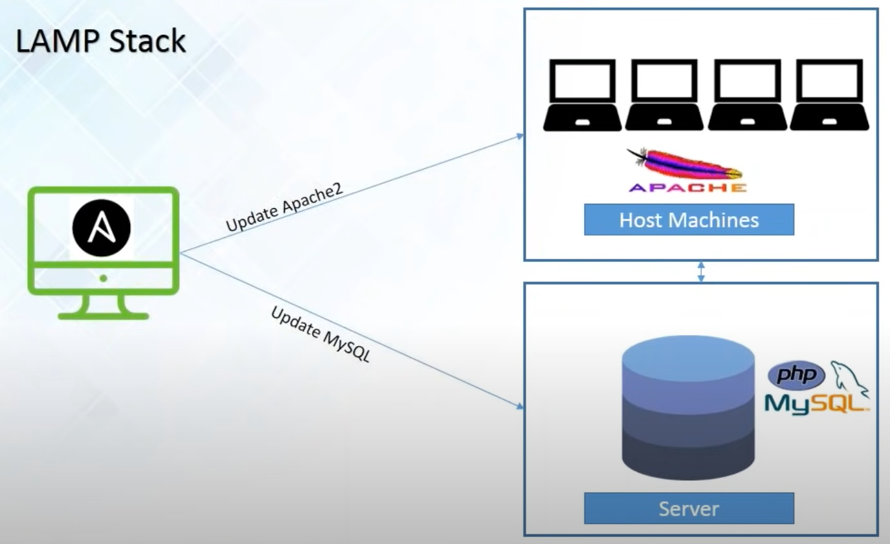
Configuration Management
Notes:
how we can attain configuration management with ansible now ansible configurations are simple data
35:46
descriptions of your infrastructure which is both human readable and machine possible and ansible requires nothing
35:53
more than an SSH key in order to start managing systems and if you start managing them without installing any
36:00
kind of agent or client software so you can avoid the problem of managing the
36:05
management which is very common in different automation systems for example I've got my host machine and our party
36:12
web server is installing each of the host machine I've also a PHP and MySQL installed if I want to make
36:17
configuration changes if I want to update a party and update my MySQL I can do it directly I can push those new
36:24
configuration details directly onto my host machines or my node machines and my server and you can do it very easily
36:31
using ansible playbooks so guys are clear about what is configuration management with ansible if make with
36:37
confirmation on the chat window

Slide 22
Hands-on with Ansible
1. Installing LAMP Stack
Install Apache Server
Install PHP
Install MySQL
Deploying a Website
Host a website on Apache server
Use MySQL and PHP to insert and store data entries from webpage

